Slide 1
Phonics and Reading Workshop
4th December 2019
Have a look at the words on your table decide if they are treasure (real words) or trash (made up words).

Slide 2
What is phonics?
A method of teaching people to read by correlating sounds with symbols in an alphabetic writing system.

Slide 3
Why do we teach phonics?
Phonics gives children a strategy to help them read and write words

Slide 4
How do we teach phonics?
Phonics is taught in a systematic and synthetic way through a
daily four-part phonics lesson

Slide 5
Six phases
Phase 1 – mainly pre school
Phases 2, 3 and 4 – Reception and Year 1
Phase 5 – Year 1
Phase 6 – Year 2

Slide 6
Phase 2
Initial sounds
Segmenting for spelling
Blending for reading

Slide 7
Phase 3
Remaining initial sounds
Sounds made from 2 letters
Middle vowel sounds – 2 or 3 letters
Blending and Segmenting

Slide 8
Phase 4
No new sounds
Focus on consonants

Slide 9
Phase 5
Remaining middle vowel sounds
Remaining sounds made from 2 letters
Split digraph sounds

Slide 10
Phase 6
Spelling Patterns
Suffixes and Prefixes

Slide 11
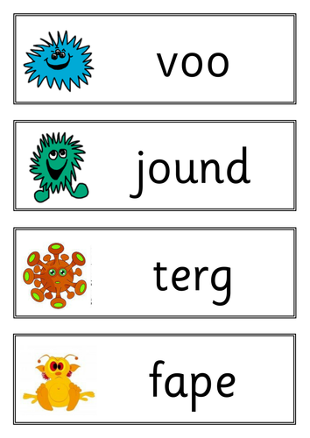
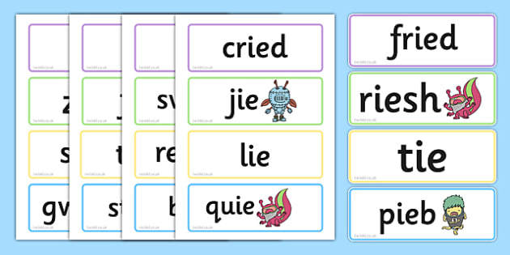
Y1 Phonics Screening Test

Slide 12
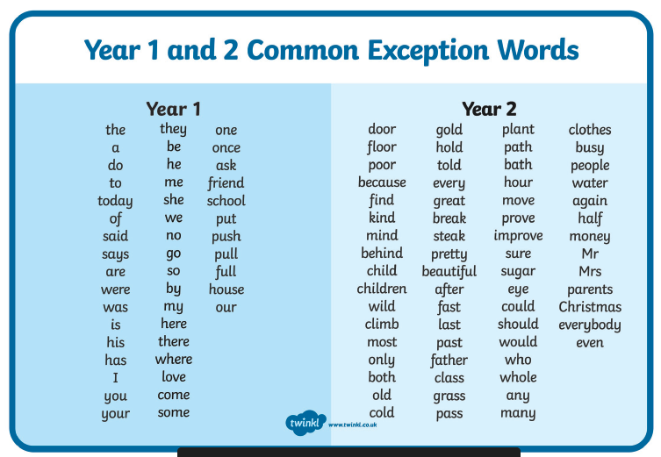
High frequency Words

Slide 13
How can you help your
child at home?
Listen to your child read every night.
Encourage children to spot the phonic sounds in the books you are reading them particularly the split digraph sounds.
Use the word flashcards to play games like pairs so the children are seeing the words lots of times.
Encourage children to talk about the what they have read and their understanding.
Use the questions and prompts on the year 1 bookmark.
B and d reversal and y and g – alphabet sounds of uncommon letters like z and w and x.

