Slide 1

Welcome to Year 3
Please help yourself to refreshments

Slide 2

Year 3 Team
Class Teacher
Mrs Raynsford
Teaching Assistants
Mrs Hammond
Mrs Rogers
Mrs Austin
PPA Teacher – Friday pm
Mrs Souadi

Slide 3
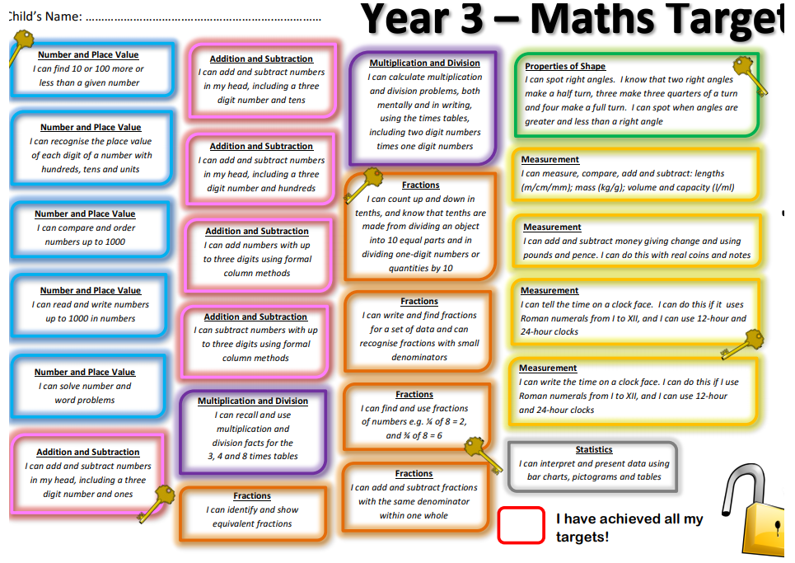
Year 3 - Keys to Success
Notes:
You will need to upload the Keys to Success from the website.

Slide 4
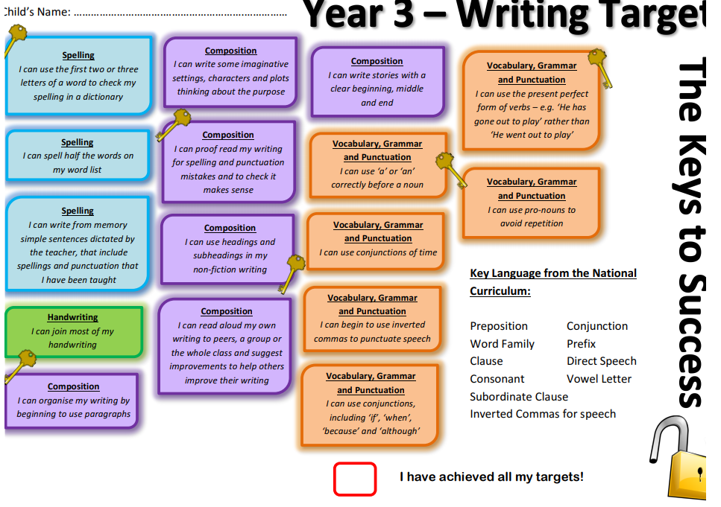
Year 3 - Keys to Success
Notes:
You will need to upload the Keys to Success from the website.

Slide 5
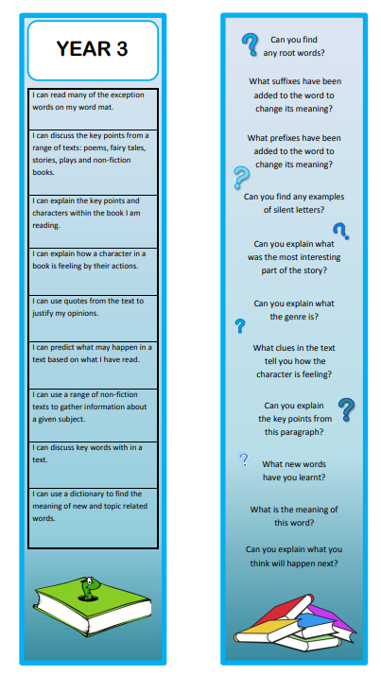
Reading Bookmarks
Notes:
Please add your year group’s book marks to this page.

Slide 6
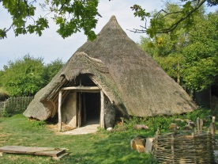
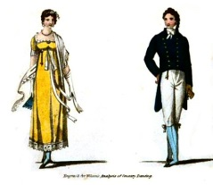
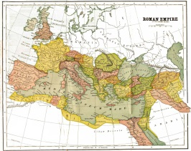

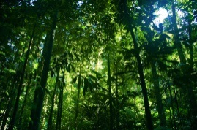
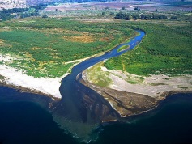

Year Four’s Curriculum
2019 - 2020
Autumn 1 | Autumn 2 | Spring 1 | Spring 2 | Summer 1 | Summer 2
How has life changed since the Stone Age? | How did Victorian children live? |  |  | Why are Rainforests important | How are rivers important?
How did the ancient Roman Empire influence our modern world?
Including the study of:
Escape from Pompeii
Destination Italy
Notes:
Please add your completed overview for the Autumn Term

Slide 7

Autumn Term
Trips
Visitors
English
History
D&T
How has life changed since the Stone Age?
How did Victorian children live?
Geography
Maths
Music
Art
Computing
R.E
PSHCE
Notes:
Please explain only key parts of the curriculum

Slide 8
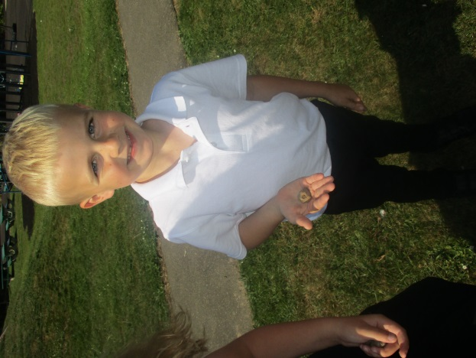
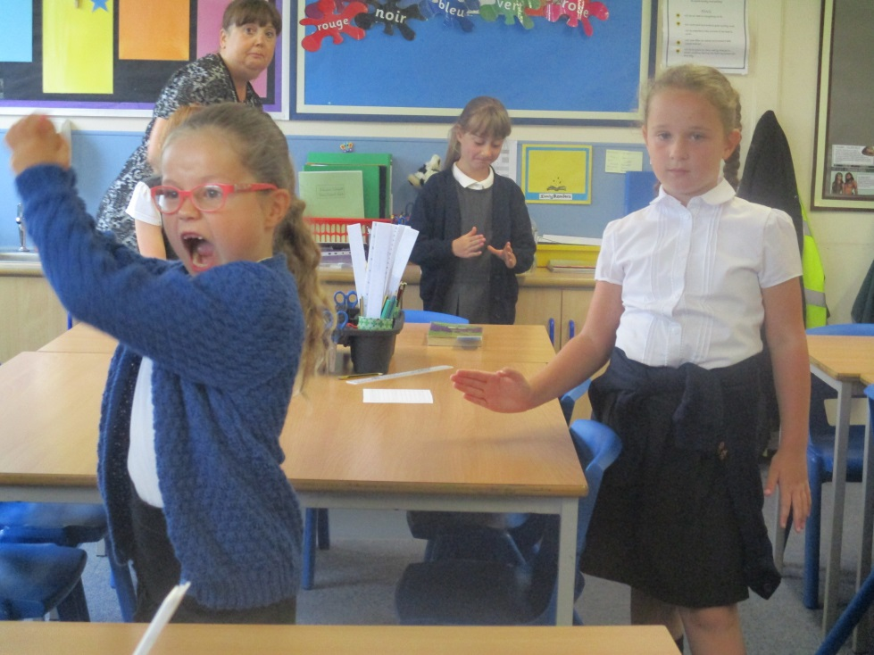
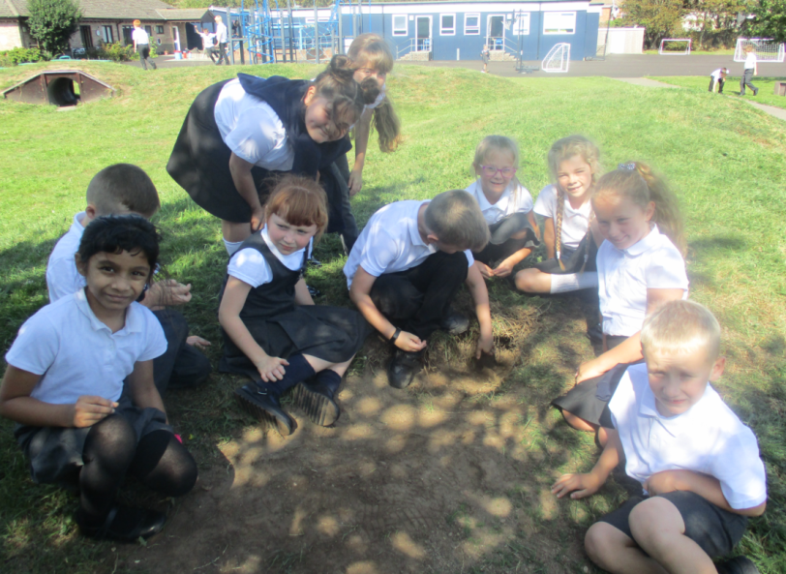
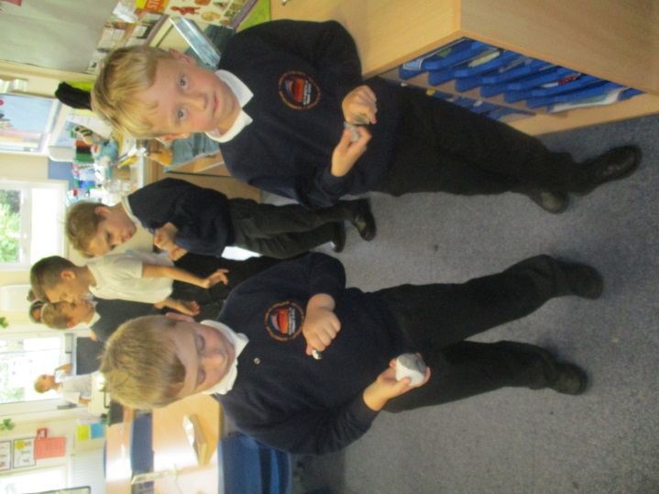
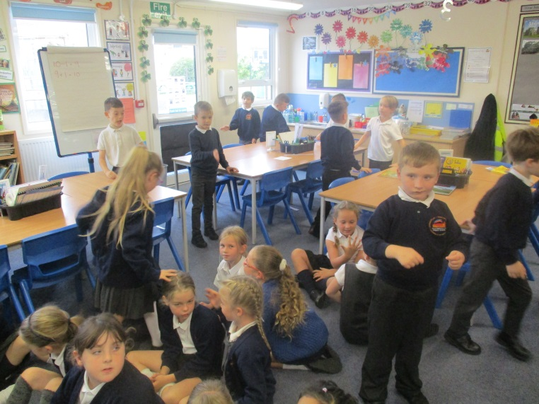
Stunning Start
Notes:
Please add pictures of your stunning start

Slide 9
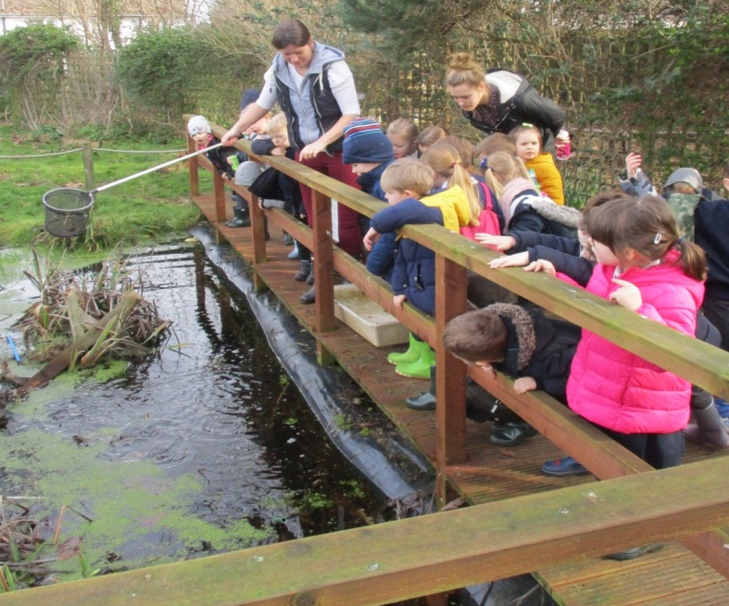
Outdoor Learning
Once a half term, pupils will take part in outdoor learning activities.
Change of clothes: long trousers, long sleeve tops and a change of footwear.
For the first half of the Autumn Term, our session will be:
Thursday 3/10/19
Notes:
Please add pictures of your stunning start

Slide 10
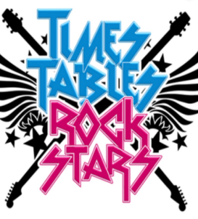

Giving your child an advantage
Reading:
Support your child’s fluency, stamina and understanding by listening to them read for at least 20 minutes a day. Please use your child’s bookmark to deepen their understanding.
Please complete your child’s reading record so we know that they have read and what they are reading.
Remember that if your child reads at least 5 times a week they will be entered into our half termly raffle draw.
Maths:
Learn number bonds to 10, 20 50 and 100. Revisit them frequently 10+0= 10, 20-2=18 , 100-25=75 etc.
Support your child in learning by using internet maths games: Times Table Rock Stars, Hit the button etc.
Encourage opportunities to explore measures and money, shopping.
Fluency in the four rules ( x ÷ - +) and fractions.
Notes:
Add and delete as appropriate

Slide 11

Spellings:
Each week your child will receive 10 spellings.
Learning their spellings will be a key part of your child’s Home Learning Task.
Writing:
Encourage lots of discussion to develop their vocabulary.
Try and write something everyday no matter how small.
Look out for the word of the week and encourage pupils to use it in the correct context.
Encourage your child to complete challenges on Active Learn linked to deepening their understanding of key grammatical terms.
Website:
Use the school’s Home Learning section for a range of interactive games: http://www.southbersted.w-sussex.sch.uk/curriculum/home-learning/
Notes:
Add and delete as appropriate

Slide 12
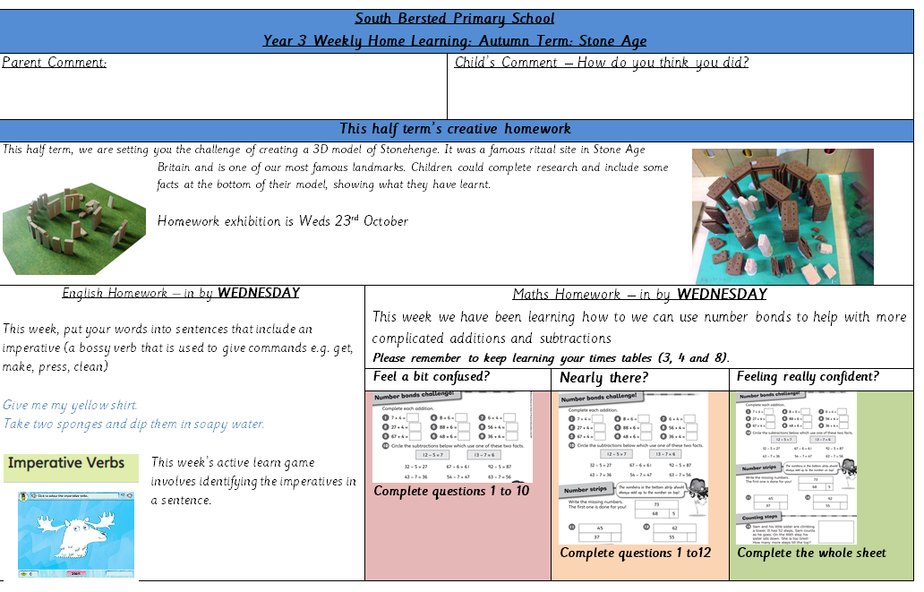
Home Learning
The format for Home Learning has a clear focus on grammar, punctuation and spellings.
Each half term, your child will also be set a Creative Home Learning Challenge.

Slide 13

P.E kit
Swimming: Friday
P.E: Gymnastics – Monday
For all physical education lessons, your child must have the correct equipment with your child’s name written clearly inside.
P.E Kit: Navy shorts
T-shirt, which is their team colour
Plimsolls or trainers (for outdoor work)
Warm clothing in winter months such as a tracksuit.
Swimming:
Towel, swimsuit, Swimming hat (provided), goggles (optional)
If your child has an ear piecing it must be removed or your child must use tape to cover their ears.

Slide 14
Healthy Minds
Please ensure that your child has a clear water bottle in school.
This year we would like to encourage pupils to bring in a healthy snack during break times. The snack must be a fruit snack.
Lunch boxes should not include sweets or a fizzy drink.
If your child is entitled to a free school meal, application forms are available from the office.
Notes:
Delete as appropriate for KS 1 or 2

Slide 15
Communication
Class Dojos for rewards and sanctions.
The School’s website.
School’s Facebook page.
Parent Mail.
Class Pages.
(http://www.southbersted.w-sussex.sch.uk/class-pages/)
Bi-weekly newsletters.
Parent teacher consultations.
Interim reports.
End of year reports.
Notes:
Please add what you give green dojos for

Slide 16
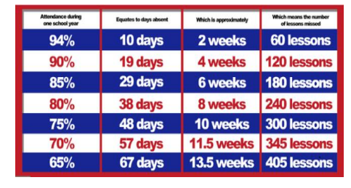
Attendance
The School Day begins promptly at 8.50am and ends at 3.15pm.
The gates open to allow access to the school at 8.40am and are closed at 8.50am. Pupils arriving after this time will be recorded as being late.
If your child arrives after 9.20am, this will be recorded as an unauthorised absence.
Attendance of 96%+ is judged to be good.
Notes:
Please add what you give green dojos for

Slide 17
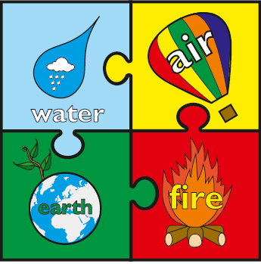

Rewards and Sanctions
Rewards
Class Dojos – linked to our whole school House System.
Aiming for Excellence,
Acts of Kindness,
Perseverance
Weekly Red Book.
Sanctions
Clear classroom expectations.
If a child is not following the class and school rules, then they
will have a verbal reminder.
If the behaviour continues they will be asked to move seats.
If the behaviour continues still they will work in a partner class.
Use of lunch time detentions.
Notes:
Currently, we are reviewing the whole school behaviour policy. At present these are our rewards and sanctions.
Please discuss the whole class rules and rewards that were created during the first week.

Slide 18
Thank you for joining us this afternoon. We look forward to working with you in supporting your child’s learning.
Are there any questions?

