Slide 1

Growth Mindset
Wednesday 26th September 2018

Slide 2

Outcomes from the workshop
Have a clear understanding of different mindsets.
Reflect on your own mindset.
Have an understanding of current research and findings.
Recognise the importance of promoting a growth mindset.
Know how we are further developing a growth mindset culture.
Know how you can further support
your child.

Slide 3

Why do some people try harder than others?
“Because some people don’t care about doing well in some areas.”
Given the choice, would anyone really choose to do badly?
Isn’t this something we tell ourselves to protect our ego?

Slide 4
Why do some people try harder than others?
Discuss as many answers as you can think of.
For each answer, ask yourself ‘Why?’
“Because some people are lazy.”
This is a description of behaviour, not an explanation for it.

Slide 5
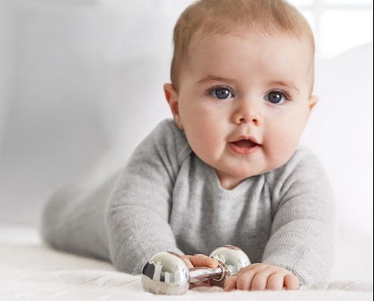
Why don’t we see unmotivated babies?
What changes?

Slide 6
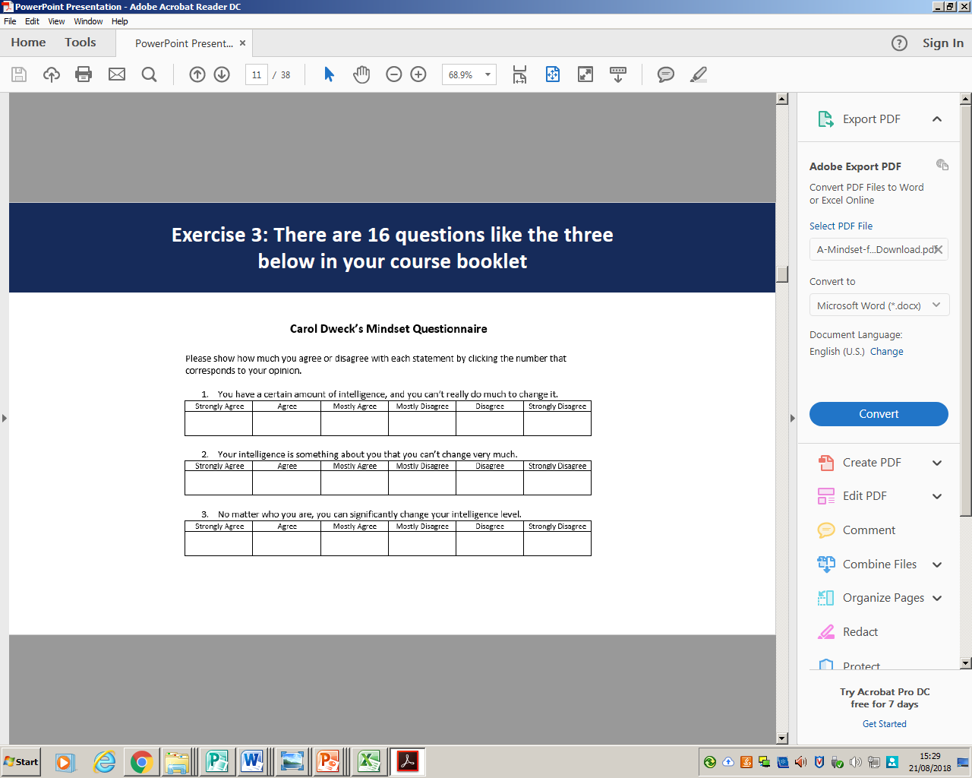
Views on Intelligence

Slide 7

Views on Intelligence

Slide 8
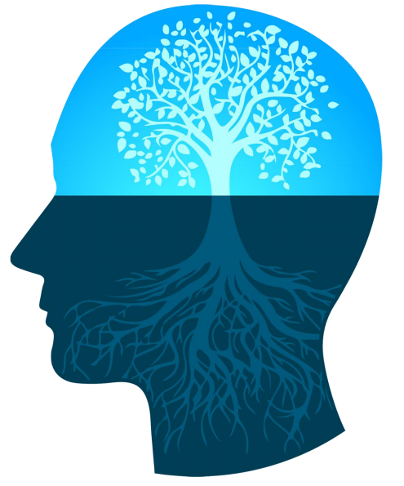
The Growth Mindset Theory

Slide 9
What is a mindset?
A mental attitude that determines how you will interpret and respond to situations.
The distinguishing feature of geniuses is their passion and dedication to their craft, and particularly, the way in which they identify, confront, and take pains to remedy their weaknesses (Good, Rattan, & Dweck, 2008).
In other words...
It’s not what you are born with that matters; it’s your mindset that matters.

Slide 10
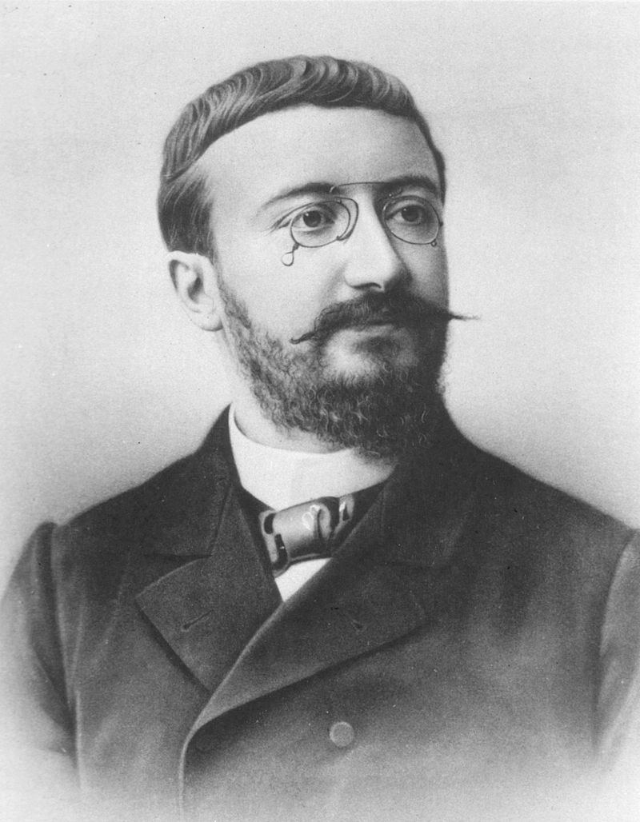
Yesterday’s Theory: We Are Born with Intelligence
No matter how much you learn or how hard you work, your intelligence stays the same!
Alfred Binet was a French psychologist who invented the first practical intelligence test, the Binet-Simon scale. His main goal was to identify students who needed special help in coping with the school curriculum.
Right: Albert Binet (1857-1911) Invented the first useable IQ test.

Slide 11
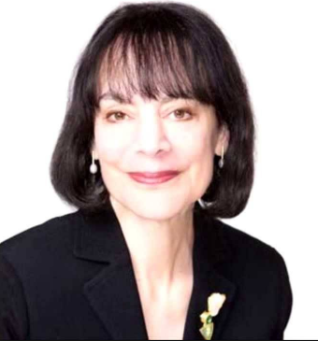
Today’s Theory: Mindsets Matter!
Carol S. Dweck, Psychologist:
‘IQ tests can measure current skills, but nothing can measure someone's potential. It is impossible to tell what people are capable of in the future if they catch fire and apply themselves.’

Slide 12
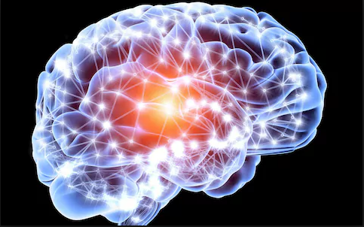
Neuroplasticity
Too often people believe the brain is static, leading them to think talent and giftedness are permanent, unchanging personal attributes that automatically bring later success.
Every time you work hard, stretch yourself and learn something new, your brain forms new connections and over time you actually become smarter.

Slide 13
Neuroplasticity in Action
How long do you think it takes to become a black cab taxi driver in London?
3 years
Taxi drivers need to be able to work out alternative routes mentally throughout the City to avoid excessive congestion.
The training was tested.
A driver’s brain development increased by 30% from the start to the end of the training.
https://www.mindsetworks.com/parents/growth-mindset-parenting

Slide 14
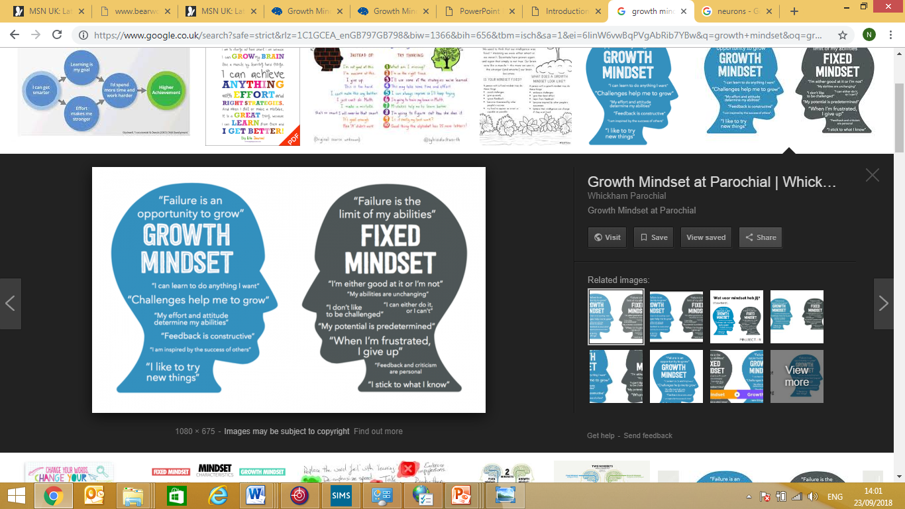

Slide 15
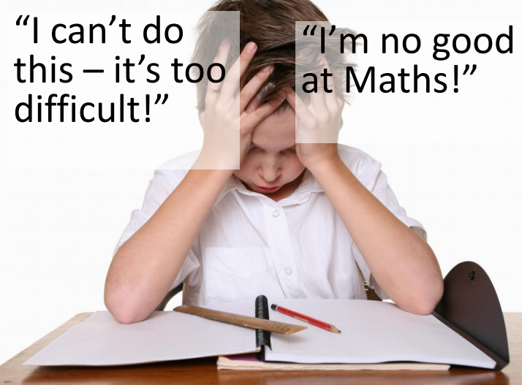

Slide 16
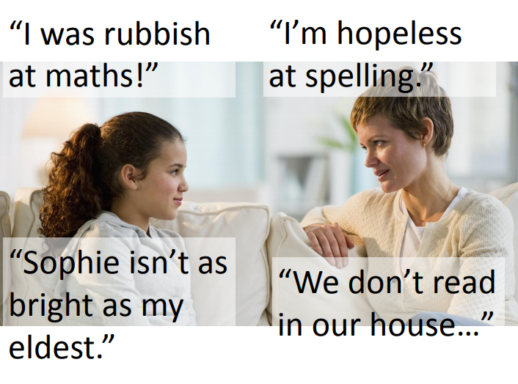

Slide 17
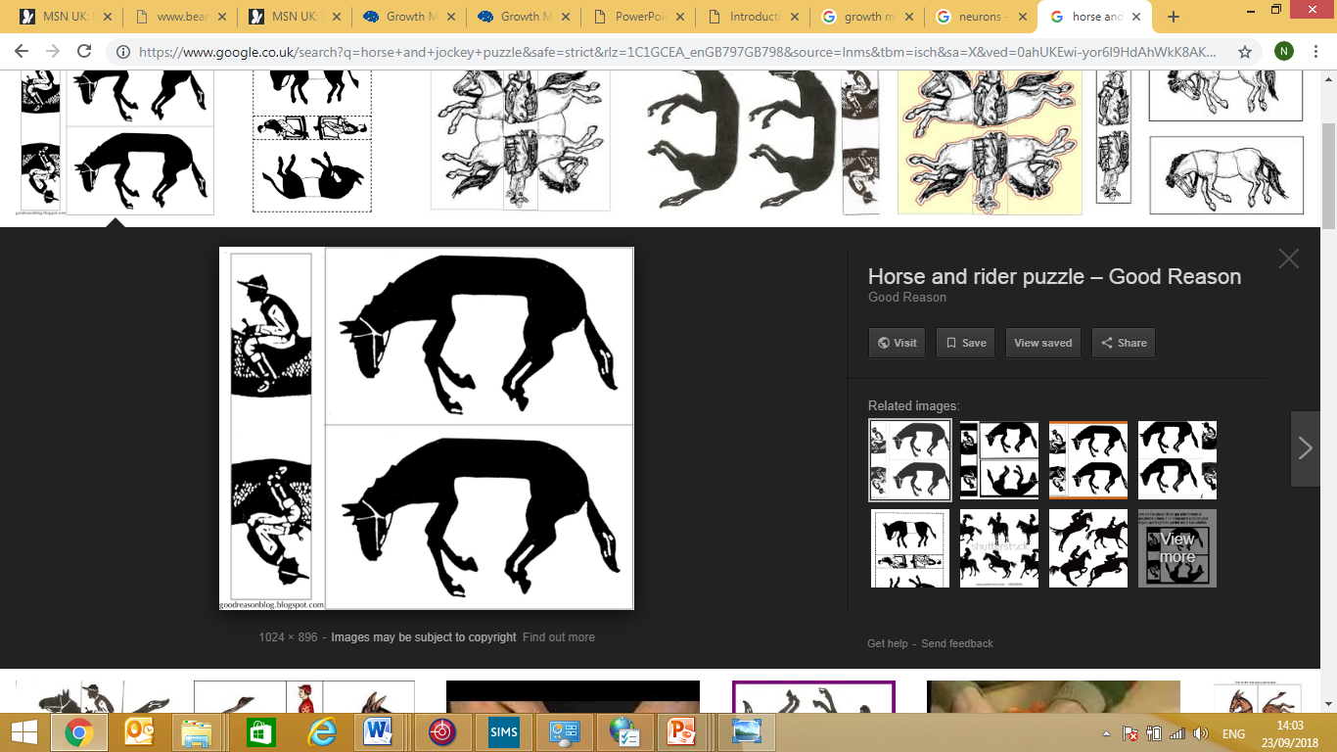

Thinking Differently

Slide 18
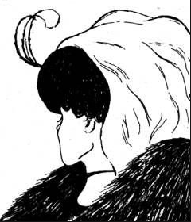

Slide 19
opportunityisnowhere

Slide 20
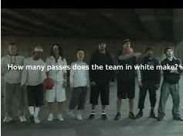

Slide 21
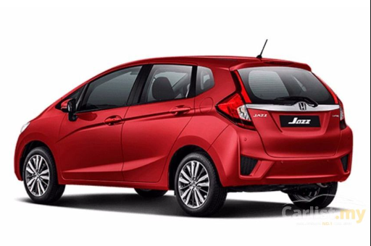

Slide 22
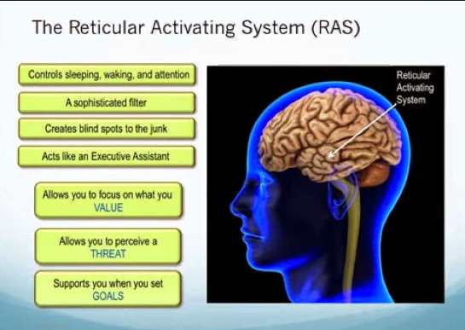

Slide 23
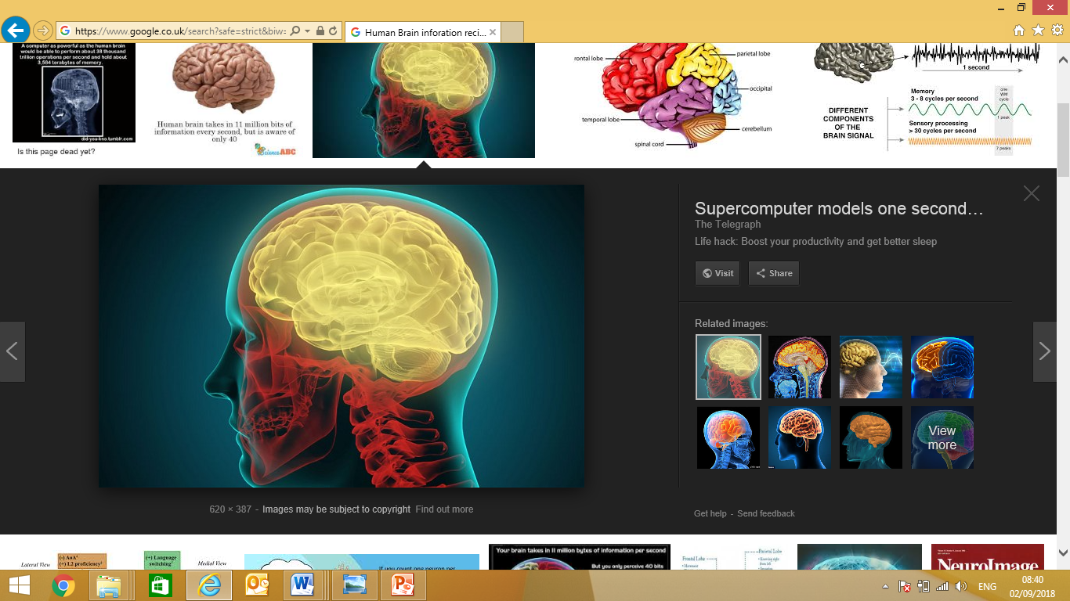

10, 000,000
sights
100,000
sounds
100,000
Smells
1, 000,000
Feelings
1,000
Tastes
Of the 11, 000, 000 bits of information per second you RAS filters 100 to the conscious mind!

Slide 24
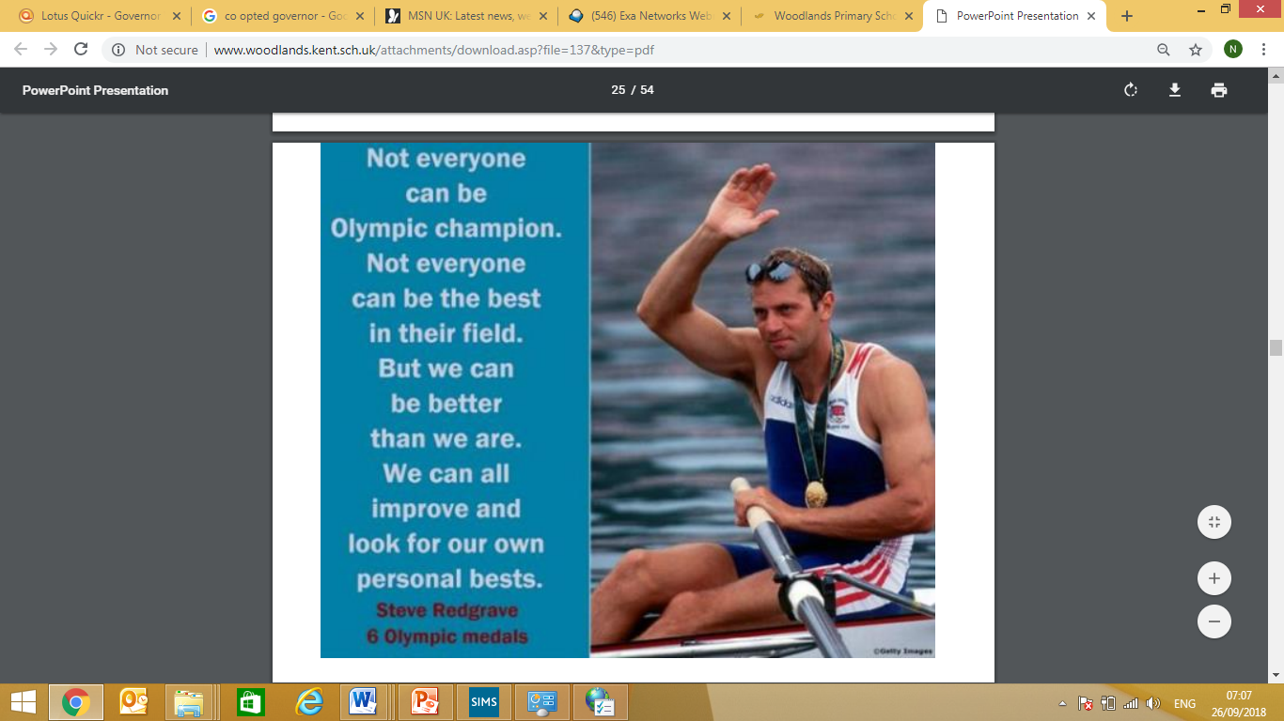

Slide 25
How are we developing a culture?
Focusing on the word challenging rather than hard.
Ensuring children recognise the importance of effort and working hard.
Celebrating progress.
Clear feedback that states next steps.
Recognising and identifying the importance of making mistakes as a way of learning.
Teaching children about the brain.
Distinguishing between doing and learning!
Positive role models.

Slide 26
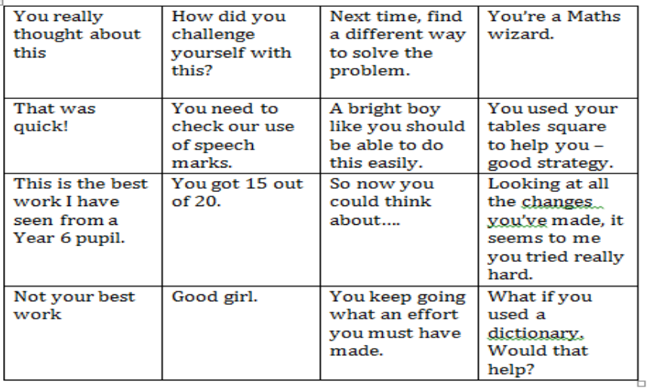
Which comments encourage a Growth Mindset?

Slide 27
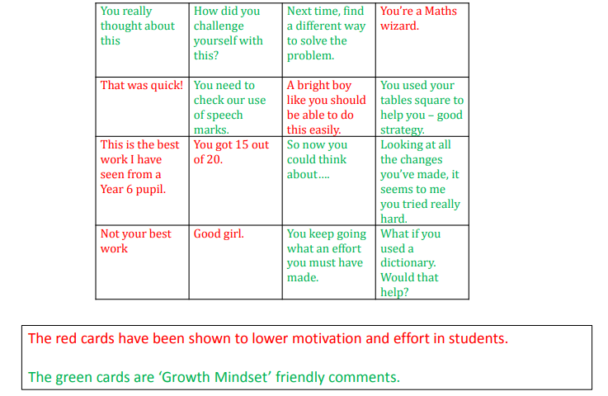
Answers

Slide 28
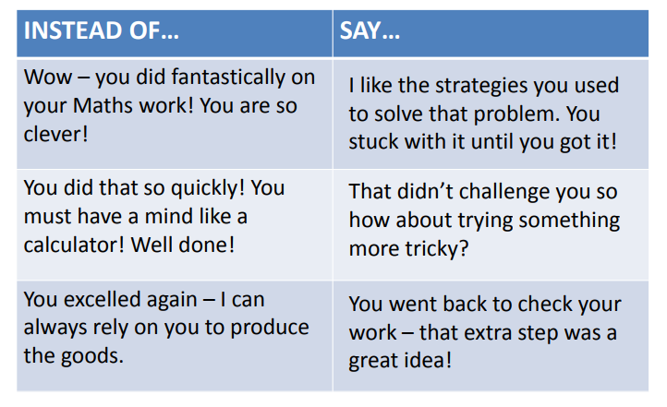
Giving Praise

Slide 29
Further Strategies
Reinforce the importance of seeking of challenges and taking risks.
Value the learning from making mistakes and celebrate failures as steps on the road to success.
Encourage Growth Mindset language ‘….yet’- ‘I cannot recall my 8 x tables yet.
Avoid general praise or intelligence praise and focus the praise on effort and the process.
Have daily learning discussions e.g. “What have you learned today?” Instead of “How was your day?”
Help children to understand that their brains can change and GROW.
Discuss new learning and develop topic related and key vocabulary.

Slide 30
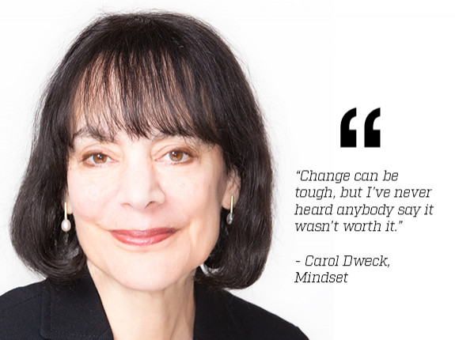

Slide 31
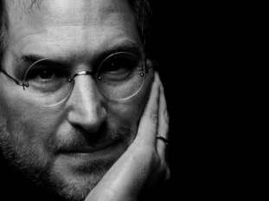
Famous Failures
Who is this describing?
At 30 years old, he was left devastated and depressed after being unceremoniously removed from the company he had started.
Steve Jobs

Slide 32
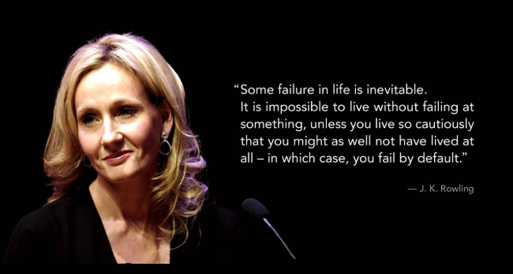
Famous Failures
Who is this describing?
She had no job, a young daughter and had lost her mother. In writing a book, she sent off the first three chapters but received many set backs with no publisher willing to take on the project.
J K Rowling

Slide 33

Famous Failures
Who is this describing?
She faced many setbacks and was fired from her role as a television reporter because she ‘was unfit for TV.’
Oprah Winfrey

Slide 34
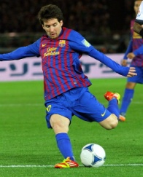
Famous Failures
Who is this describing?
At the age of 11 I was diagnose with growth hormone deficiency. This meant that he did not grow tall enough to play football professionally and no club was willing to pay the $900 a month for his treatment.
Lionel Messi

Slide 35
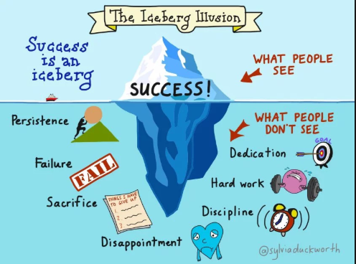
https://www.youtube.com/watch?v=lGCP154Ojy8

