Slide 1

Bedtime Breakfast
Friday 4th October 2019

Slide 2
Outcomes
To reflect on the importance of developing children’s vocabulary,
Reflect on the impact of reading,
Know how we teach reading to your child,
Know the strategies that you can use to develop a love of reading and your child’s vocabulary.

Slide 3
When does your child learn to read?
Readers from birth,
Children learn quickly that we communicate via spoken language,
Babies are sung to, laughed at, talked to, listened to,
Children understand that print conveys meaning when adults read aloud to them and when they see adults reading.

Slide 4
What makes a skilled and confident reader?
Opportunities to:
Build spoken language by talking and listening,
Learn about print and books,
Learn about the sounds in spoken language (this is called phonological awareness),
Learn about the letters of the alphabet and how they come together to form words,
Listen to books read aloud.
Every one of these elements is vital!

Slide 5
Build spoken language by talking and listening
1 years old:
Know a lot about spoken language,
Recognise some environmental and speech sounds,
Know words that are important to them,
Begin to imitate those sounds.
Children learn all of this by listening to family members talk. Children who do not hear a lot of talk and who are not encouraged to talk themselves often have problems learning to read.

Slide 6

Listening to books read aloud
Reading aloud = single most important activity for building knowledge required for success in reading (and writing!).
Reading aloud supports:
Self esteem,
Positive attitudes/social values,
Development of rich vocabulary,
Children learn new concepts,
Develops listening and attention skills,
Make connections between spoken/written words,
Profile of reading – shows its important to us as adults!
Children learn the JOY of reading!

Slide 7
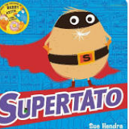
Vocabulary Development
One of the biggest barriers to reading comprehension is impoverished vocabulary,
Do not assume that your child knows the word or context of the word.

Slide 8
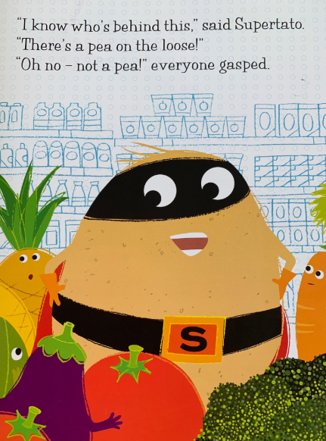

Slide 9
Vocabulary Development
Pronunciation,
Clap syllables,
Give a clear definition,
Actions and rehearsal – (repetition is really important to ensure children learn new words!),
Use of the word in different contexts.

Slide 10
Reading at School
From 14th October, each child will be heard to read on a 1:1 twice a week,
Once a week guided reading sessions,
Daily phonics lessons,
Class story at the end of the day,
Topics and learning activities are driven by texts.

Slide 11
Reading Rich Home Environment
How?
Establish a regular time (before bed/bath time works well),
Keep a large variety of reading materials at hand,
Store books/materials in places children can access,
Get library cards for whole family,
Share your love of books with them/advertise the joy of reading!
Have paper and writing tools available along side,
Model reading and writing for pleasure,
Make time for conversations about books and reading,
Use board games to reinforce language/literacy skills.

Slide 12
Vocabulary Development
Pronunciation,
Clap syllables,
Give a clear definition,
Actions and rehearsal – (repetition is really important to ensure children learn new words!),
Use of the word in different contexts.
Notes:
https://readingwithyourkids.com/why-is-reading-with-your-kids-so-important/

